Slide 1
Mediation, Negotiation And Arbitration In Conflict Resolution
Name
Institution

Slide 2
Introduction
Legal cases can be solved by :
a)Mediation
b)Arbitration
c)Negotiation
The mode of which a case is solved depends on the nature of the dispute and the parties involved.

Slide 3
Mediation
Case: Resolution of environmental dispute in Indonesia.
Case involved the public and individual companies.
Complaints included: rapid deforestation in the land, industrialization that did not favor the people and large scale mining activities.

Slide 4
Mediation
In 1977, an act on Environmental disputes Management was set up to enable solving of the case by mediation.
There were:
a)Public claims-The people wanted the environment restored.
b)Private claims- compensation of personal damage.

Slide 5
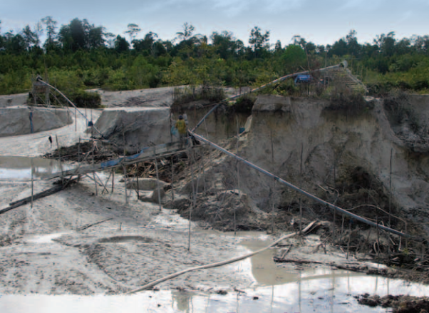
Environmental destruction in Indonesia

Slide 6
Negotiation
Case: Legal cases of Inferior alveolar nerve (IAN) injury during implant removal.
This is an avoidable complication thus had medico-legal implications.
The case was 4 patients identified against the doctors.
Patients experienced numbness, affected functionality and neuropathic pain in the area.

Slide 7
Negotiation
After negotiation, recommendations made include:
a)Early removal of implants
b)Use of corticosteroids and high dose Non-steroidal therapy reduced complications.

Slide 8
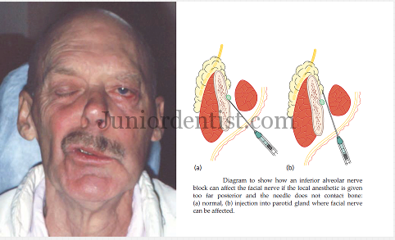
Results Of Ian injury.

Slide 9
Arbitration
Case: Defamation liability on Website owners in Israel.
The Legal system of Israeli has had to solve cases between individuals and website owners over content posted on websites.
The content had been posted as posts on Facebook or tweets on twitter. The owners were the defendants.

Slide 10
Arbitration
The cases were solved in discourses held in the virtual town hall.
The cases were solved as:
a)The plaintiffs were compensated.
b)The websites were asked to monitor content posted and that they should remove any defamatory content.

Slide 11
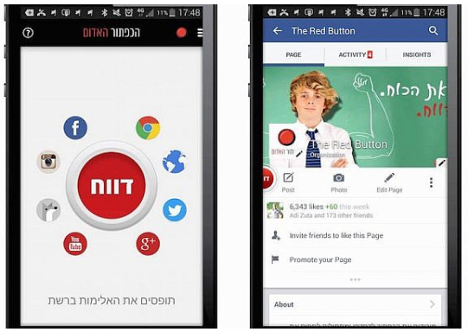
Application To Help With Cyber Defamation

Slide 12
References
Nicholson, D. (2010). Environmental dispute resolution in Indonesia. Environmental dispute resolution in Indonesia. Brill. https://doi.org/10.26530/oapen_379132
Volovelsky, U., & Raynzilber, R. (2013). The liability of website owners for defamation in Israel: A challenge yet to be solved? In Computer Law and Security Review (Vol. 29, pp. 590–600). https://doi.org/10.1016/j.clsr.2013.07.011

Slide 13
REFERENCES
Juodzbalys, G., Wang, H. L., Sabalys, G., Sidlauskas, A., & Galindo-Moreno, P. (2013). Inferior alveolar nerve injury associated with implant surgery. Clinical Oral Implants Research, 24(2), 183–190. https://doi.org/10.1111/j.1600-0501.2011.02314.x

Slide 14
IMAGE SOURCES
PANDULA, V. (2020)Complications of Inferior Alveolar Nerve Block – Transient Hemi facial paralysis treatment
Nicholson, D. (2010). Environmental dispute resolution in Indonesia. Environmental dispute resolution in Indonesia. Brill. https://doi.org/10.26530/oapen_379132

Slide 15
Image Sources
SHAMAH, D. (2020). In first, Israeli app helps kids beat cyber-bullies. Retrieved 19 April 2020, from https://www.timesofisrael.com/in-first-israeli-app-helps-kids-beat-cyber-bullies/

